Slide 1
JUNIOR DIVERSE. INCLUSIVE. TOGETHER. PATCH VIRTUAL MEETING PLAN
Overview
This slide deck walks you through activities to complete all or most steps of this patch. It includes a variety of interactive activities that you can do as a troop – including video, group conversations, hands-on activities, and more. Review the full deck and notes section prior to your meeting for tips and suggestions. In addition, these first slides will outline the general meeting plan.
Depending on the length of your virtual meetings, you may choose to complete this badge over the course of 1-2 meetings. Connect with families ahead of time to let them know what materials they should have ready prior to logging in. Patches can be purchased by the troop or families in the online shop.
Materials Needed
Paper
Writing utensils
Notes:
Overview for the troop leader

Slide 2
A Note to Leaders ​
For a long time, many people, including social learning experts, believed that if we didn’t call attention to racial​ differences, then children would be less likely to notice these biases themselves and therefore, less likely to​ discriminate against others. This is commonly known as the “colorblind” approach to handling discussions and​ interactions dealing with race.​
​
Research, however, has since disproven this theory. Studies have shown that children notice and begin assigning​ meaning to race at a very young age (examples of this include distinguishing between white and black people, and​ drawing conclusions about traits inherent to those groups of people). The good news is that research has shown that​ parents and guardians who meaningfully talk to their kids about race end up with better racial attitudes than kids with​ parents or guardians who don’t.​
​
Erin N. Winkler, a professor at the University of Wisconsin who studies racial identity, states, “Children pick up on the​ ways in which whiteness is normalized and privileged in U.S. society.” When working through these activities with your​ troop, make a concerted effort not to make whiteness the default and inadvertently marking other races as “other.”​
Notes:
Overview for the Troop Leader

Slide 3
Preparation & Resources For Facilitation​
Prep​
Before the meeting, familiarize yourself with the content and terms. The additional resource information will be helpful to read and engage in prior to the meeting so that you feel ready to facilitate conversations about identities including discussions on prejudice and racism.
Resources for Facilitation​
How To Talk to Kids about Racism ​
Resources for Talking about Racism and Racialized Violence with Kids ​
Establishing Brave Spaces: The Roles of Safety and Comfort in Dialogue ​
Girl Scouts River Valleys’ Additional Resources​
In the Loop blog (“Diversity, Equity, & Inclusion” category)
GIRL Talk podcast (Episode #10 “Talking About Race and Difference”)
Notes:
Overview for the Troop Leader
https://www.today.com/parents/how-talk-kids-about-racism-protests-injustice-t182929
https://centerracialjustice.org/resources/resources-for-talking-about-race-racism-and-racialized-violence-with-kids/
https://www.bc.edu/content/dam/files/centers/humanrights/pdf/IGR.Brave Spaces Handout.pdf
https://volunteers.girlscoutsrv.org/category/in-the-loop/diversity-equity-and-inclusion/
https://girltalk.girlscoutsrv.org/2019/06/26/episode-010-talking-about-race-and-difference/

Slide 4
Junior Diverse. Inclusive. Together. Patch Virtual Meeting Overview
Activity | Slide Number | Time | Notes
Intro/Promise & Law | Slide 5 – 7 | 5 min
Icebreaker | Slide 8 | 5 min
Did You Know? | Slide 9 – 10 | 10 min
Hand Identity Charts | Slide 11 – 13 | 15 min
What Does It Mean to Be Prejudiced? | Slides 14 | 5 min
Diverse Book Club! | Slides 15 – 17 | 15 min
Closing | Slides 18 | 5 min
Notes:
Overview for the troop leader

Slide 5
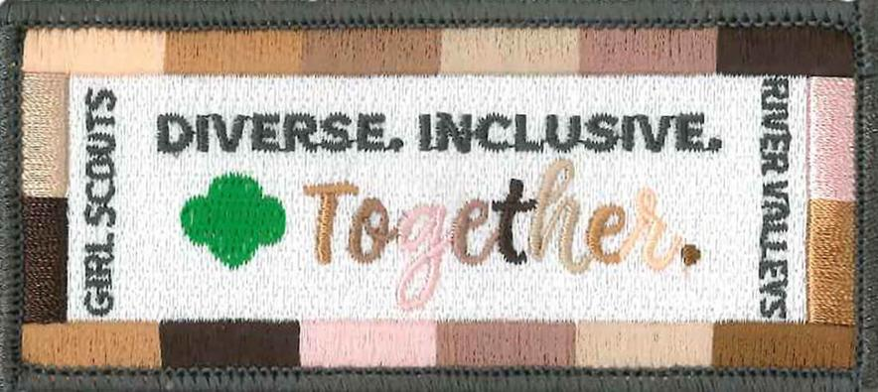
Junior Diverse. Inclusive. Together. Patch
GIRL SCOUTS RIVER VALLEYS
Notes:
Junior Diverse. Inclusive. Together. Patch
Patch purpose: When girls have earned this patch, they’ll have developed an appreciation of the uniqueness and commonalities of themselves and others, and the rich diversity of various cultures in their community and in the world. Girls will also deepen their understanding and respect for people who may be different from them, and learn how to better relate to others.

Slide 6
Say the Girl Scout Promise
On my honor, I will try: ​
To serve God* and my country,​To help people at all times, ​And to live by the Girl Scout Law.​​​
*Members may substitute for the word God in accordance with their own spiritual beliefs.​​​
Notes:
Open your meeting with the Girl Scout Promise and Law.​

Slide 7
I will do my best to be
honest and fair,
friendly and helpful,
considerate and caring,
courageous and strong, and
responsible for what I say and do,
And to
respect myself and others,
respect authority,
use resources wisely,
make the world a better place, and
be a sister to every Girl Scout.
Say the
Girl Scout Law
Notes:
Open your meeting with the Girl Scout Promise and Law.​

Slide 8
Ice breaker!
Would you rather be ten years older than you are now, or four years younger?
Notes:
Ice breaker question

Slide 9
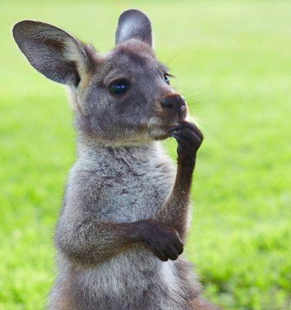
Did you know...?
Pretend you don’t know me. What do you think you know just by looking at me?
Is there a lot you can tell about someone just by looking at them?
Notes:
Set up the scenario: Pretend you don’t know me. What do you think you know just by looking at me? (There’s not a lot we can tell about someone just by their physical appearance.) Ask girls if there’s a lot you can tell about someone just by looking at them.
Have girls think (not out loud!) about a little-known fact about themselves. Remind them that this fact will be shared with the group, so it should be a fact they’re comfortable revealing to the group.
When they’re ready, they should type in this fact in the chat box and send directly to you (they can do this by selecting your name from the participant list in the chat box).
MATERIALS:​
Paper
Writing utensil

Slide 10
1
Listen as I read each
little-known fact
2
Guess who shared that fact about themselves
3
Reveal the answers!
Notes:
After everyone has sent in their fact, read each one aloud and have girls guess who shared that fact about themselves. Have girls jot down their answers on a piece of paper. Continue until you’ve read through all the facts. Then have girls reveal which fact belonged to them.
After the activity, reflect:
How did girls do?
Was it easy or hard to pair the fact with its owner?
It can be hard to tell a lot about someone just by looking at them. There are so many unique aspects of our identity that other people can only discover by getting to know us.

Slide 11
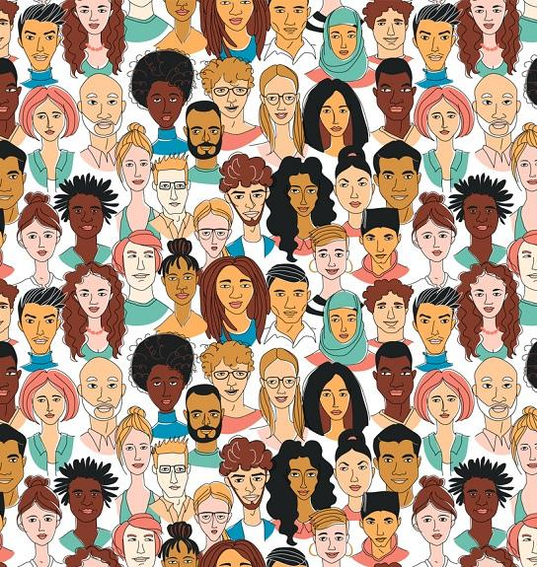
What makes you you?
Let's talk about identity!
Notes:
Use the whiteboard feature in Zoom to write “identity” at the top of the screen. Ask girls what they think the word “identity” means. They can write their responses on the whiteboard themselves, or you can do it for them. (If you’re not using Zoom or another audio/video program with a Whiteboard feature, you can also share your screen and type responses in a Word document.)
Once girls have a chance to answer, explain that your identity is made up of the individual characteristics, beliefs, interests, and groups that you belong to. Sometimes these characteristics are visible, and sometimes they’re invisible.
Remember the activity we just did? What can you tell just by looking at someone?
Then, clear the whiteboard (or your Word document). Now, ask girls to come up with a list of categories that people commonly use to define their identity.
(If they’re stumped, some examples you could start the conversation rolling: gender, age, hobbies, religion, race or ethnicity, what school you go to, what sports you play, where your family is from, etc.) After they’ve come up with their own answers, you can share the next slide.

Slide 12
How do people define their identity?
Age
Hobbies
Where they go to school
Where their family is from
Religion
How do you define your identity?
Notes:
Here are some other categories people commonly use to define their personal identity.
Ask girls to take out a sheet of paper and a writing utensil. Draw an outline of their hand. On the inside of hand, have girls write down words that they would use to describe themselves. On the outside of the hand, have girls write down words that others would use to describe them.
Give girls a few minutes to complete their identity charts. You can stop sharing your screen so girls can chat and see each other as they complete this activity.
MATERIALS:​
Paper
Writing utensil

Slide 13
Share your identity charts
Did the words you wrote inside your hand match the ones you wrote on the outside?
Which words overlap?
Which ones don’t?
Do you think the world sees you the same way that you see yourself?
Why do you think that is?
Notes:
After girls are finished, ask them to share their completed identity charts. If they seem hesitant to share, break the ice by sharing your completed chart first. (Note: If some girls are unwilling to share, respect their decision, and let them know they can choose to share later on the in the meeting or in the future if they change their minds.)
After everyone has shared their identity charts, ask:
Did the words you wrote inside your hand match the ones you wrote on the outside?
Which words overlap? Which ones don’t?
Do you think the world sees you the same way that you see yourself?
Why do you think that is?

Slide 14
What does the word prejudice mean?
Prejudice means judging someone or having an idea about someone before you actually know anything about them.
How can we reduce our prejudice?
One way is to learn about different people. A great way to do this is through stories. Stories are a powerful way to learn about ourselves and people who might be different from us.
Notes:
Ask girls if they’ve heard of the word “prejudice,” and if they have, what the definition of the word is. The word can be broken up into “pre” and “judge.” What can they infer from those words?
Review the definition of “prejudice.” Prejudice means to judge someone or having an idea about someone before you actually know anything about them.
When you think back to the activity we just did, the way that people see you on the outside can be a type of prejudice.
How can we reduce our prejudice? One way is to learn about different people. A great way to do this is through stories. Stories are a powerful way to learn about ourselves and people who might be different from us.

Slide 15
Meet Marley Dias
Notes:
Watch the video of Marley Dias:
https://youtu.be/utTSMzfDZcA

Slide 16
1
What was the video about?
2
SKIL 2
What kinds of books does Marley enjoy reading?
Let's discuss!
3
What did Marley notice about the books she was reading in school?
How did Marley take action to make sure other kids had access to more books that reflected their own experience?
4
Notes:
Have a discussion about the video girls just watched.

Slide 17
Diverse Book Club!
Pick a diverse book to read
After you're done, reflect and share your thoughts with another troop member!
Some writing prompts:
I liked/didn’t like this book because…
This book made me think about…
I think you’d like this book because…
Notes:
Prior to the meeting, navigate through the Our Story website to familiarize yourself with it.
Pull up the website Our Story, which catalogs a wide array of diverse books for kids 12 and under. After the meeting, have girls each pick a diverse book to read. After they’ve read their book, set up a pen pal system so girls can reflect on what they read and recommend the book to another member in their troop.
Some writing prompts:
I liked/didn’t like this book because…
This book made me think about…
I think you’d like this book because…

Slide 18
Yay! You've earned the Diverse. Inclusive. Together. patch!
Notes:
Junior Diverse. Inclusive. Together. Patch
Patch purpose: When girls have earned this patch, they’ll have developed an appreciation of the uniqueness and commonalities of themselves and others, and the rich diversity of various cultures in their community and in the world. Girls will also deepen their understanding and respect for people who may be different from them, and learn how to better relate to others.

