Slide 1
DAISY + BROWNIE DIVERSE. INCLUSIVE. TOGETHER. PATCH VIRTUAL MEETING PLAN
Overview
This slide deck walks you through activities to complete all or most steps of this patch. It includes a variety of interactive activities that you can do as a troop – including video, group conversations, hands-on activities, and more. Review the full deck and notes section prior to your meeting for tips and suggestions. In addition, these first slides will outline the general meeting plan.
Depending on the length of your virtual meetings, you may choose to complete this badge over the course of 1-2 meetings. Connect with families ahead of time to let them know what materials they should have ready prior to logging in. Patches can be purchased by the troop or families in the online shop.
Materials Needed
Paper
Writing utensils
Acrylic paints
Paintbrush
Notes:
Overview for the troop leader

Slide 2
A Note to Leaders ​
For a long time, many people, including social learning experts, believed that if we didn’t call attention to racial​ differences, then children would be less likely to notice these biases themselves and therefore, less likely to​ discriminate against others. This is commonly known as the “colorblind” approach to handling discussions and​ interactions dealing with race.​
​
Research, however, has since disproven this theory. Studies have shown that children notice and begin assigning​ meaning to race at a very young age (examples of this include distinguishing between white and black people, and​ drawing conclusions about traits inherent to those groups of people). The good news is that research has shown that​ parents and guardians who meaningfully talk to their kids about race end up with better racial attitudes than kids with​ parents or guardians who don’t.​
​
Erin N. Winkler, a professor at the University of Wisconsin who studies racial identity, states, “Children pick up on the​ ways in which whiteness is normalized and privileged in U.S. society.” When working through these activities with your​ troop, make a concerted effort not to make whiteness the default and inadvertently marking other races as “other.”​
Notes:
Overview for the Troop Leader

Slide 3
Preparation & Resources For Facilitation​
Prep​
Before the meeting, familiarize yourself with the content and terms. The additional resource information will be helpful to read and engage in prior to the meeting so that you feel ready to facilitate conversations about identities including discussions on prejudice and racism.
Resources for Facilitation​
How To Talk to Kids about Racism ​
Resources for Talking about Racism and Racialized Violence with Kids ​
Establishing Brave Spaces: The Roles of Safety and Comfort in Dialogue ​
Girl Scouts River Valleys’ Additional Resources​
In the Loop blog (“Diversity, Equity, & Inclusion” category)
GIRL Talk podcast (Episode #10 “Talking About Race and Difference”)
Notes:
Overview for the Troop Leader
https://www.today.com/parents/how-talk-kids-about-racism-protests-injustice-t182929
https://centerracialjustice.org/resources/resources-for-talking-about-race-racism-and-racialized-violence-with-kids/
https://www.bc.edu/content/dam/files/centers/humanrights/pdf/IGR.Brave Spaces Handout.pdf
https://volunteers.girlscoutsrv.org/category/in-the-loop/diversity-equity-and-inclusion/
https://girltalk.girlscoutsrv.org/2019/06/26/episode-010-talking-about-race-and-difference/

Slide 4
Daisy + Brownie Diverse. Inclusive. Together. Patch Virtual Meeting Overview
Activity | Slide Number | Time | Notes
Intro/Promise & Law | Slide 5 – 7 | 5 min
Icebreaker | Slide 8 | 5 min
Our Troop is Similar and Different! | Slide 9 – 12 | 15 min
Our Many Colors | Slide 13 – 14 | 15 min | If you divide this plan into two meetings, consider stopping after this activity and have girls share their completed (and dry) paintings at the next meeting.
What Do You Notice When You Look at Someone Else? | Slides 15 – 16 | 5 min
Talking About and Speaking Up Against Racism | Slides 17 – 20 | 15 min
Closing | Slides 21 – 22 | 5 min
Notes:
Overview for the troop leader

Slide 5
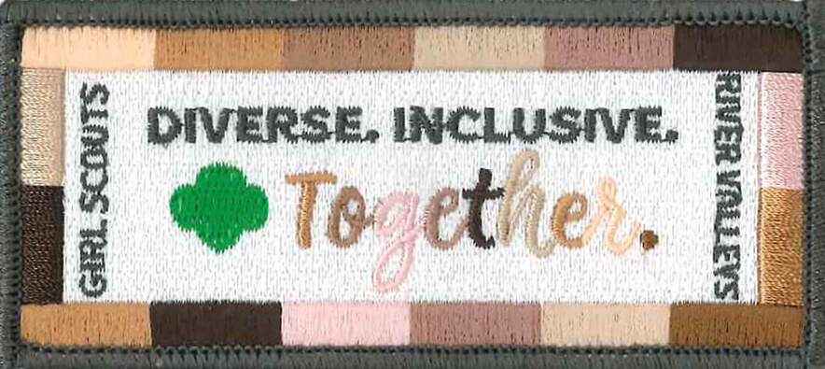
Daisy + Brownie Diverse. Inclusive. Together. Patch
Girl Scouts River Valleys
Notes:
Daisy and Brownie Diverse. Inclusive. Together. Patch
Patch purpose: When girls have earned this patch, they’ll have developed an appreciation of the uniqueness and commonalities of themselves and others, and the rich diversity of various cultures in their community and in the world. Girls will also deepen their understanding and respect for people who may be different from them, and learn how to better relate to others.

Slide 6
Say the Girl Scout Promise
On my honor, I will try:
To serve God* and my country,
To help people at all times,
And to live by the Girl Scout Law.
*Members may substitute for the word God in accordance with their own spiritual beliefs.​​
Notes:
Open your meeting with the Girl Scout Promise and Law.​

Slide 7
Say the Girl Scout Law
I will do my best to be
honest and fair,
friendly and helpful,
considerate and caring,
courageous and strong, and
responsible for what I say and do,
and to
respect myself and others,
respect authority,
use resources wisely,
make the world a better place, and
be a sister to every Girl Scout.
Notes:
Open your meeting with the Girl Scout Promise and Law.​

Slide 8
Ice breaker!
IF YOU COULD BE ANY ANIMAL, WHAT WOULD YOU BE?
Notes:
Ice breaker question

Slide 9
Our troop is similar and different!
WHAT ARE SOME THINGS WE HAVE IN COMMON?
WHAT ARE SOME THINGS THAT ARE DIFFERENT?
Notes:
Ask girls to name some things that their troop has in common. (Example, we all live in the same town, we’re all in the same grade, we go to the same school, we all like ice cream, etc.)
Then ask girls to name some things that are different about their troop. (Example, we celebrate different holidays, we play different sports, we have different houses, etc.)

Slide 10
We're the same and different!
Let's explore some of these similarities and differences with the members of our troop!
Break out into pairs. What do you have in common? What's different about the two of you?
Notes:
Tell girls that even though we’re all part of the same troop, there are many things that are different about them. Today, we’ll explore some of those similarities and differences with your troop members!
Girls will be breaking out into pairs (use the breakout room function in Zoom for this activity and have a parent/guardian in each breakout room to supervise/facilitate). Before they go into their breakout rooms, review the instructions for the activity (next slide).
MATERIALS:​
Paper
Writing utensil

Slide 11
You
Your partner
Notes:
Draw a Venn diagram on a sheet of paper. On one side, write your own name, and write your partner’s name on the other side.
Each pair should answer the same set of questions:
What’s your favorite food?
What’s your favorite color?
What’s your favorite animal?
What holidays do you celebrate?
Who’s in your family?
What do you like to do for fun?
What makes you happy?
What makes you sad?
What makes you feel special?
If you and your partner share the same answer, write it in the middle of the Venn diagram; otherwise, write down the answers under each person’s name.
Allow each pair five or six minutes to complete the questions. Then call girls back from their breakout rooms.

Slide 12
What did you find out?
EVERYONE HAS SOMETHING THAT MAKES THEM DIFFERENT FROM OTHER PEOPLE. THAT’S WHAT MAKES YOU YOU! HOW COOL IS THAT?
Notes:
Ask each pair to share what they had in common, what things were different.
Everyone has something that makes them different from other people. That’s what makes you you! How cool is that?

Slide 13
Read All the Colors We Are
Notes:
Another way that we’re all special and different from each other is the color of our skin. Everyone in the room has a different color skin, and no two skin colors are exactly the same. There might even be variations in color on different parts of your own body.
Play the video “All the Colors We Are”:
https://www.youtube.com/watch?v=Ol1hI9B9bzY

Slide 14
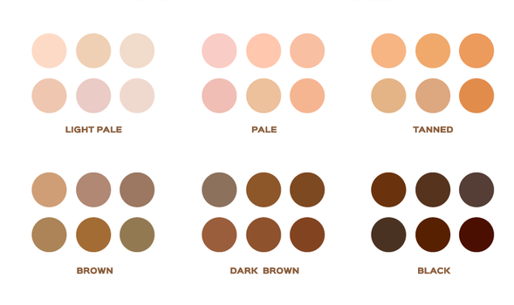
OUR MANY COLORS
Create a self-portrait!
Notes:
As we saw, though we call white people “white” and Black people “Black,” their skin tone isn’t really white or Black. Actually, people are all different kinds of skin tones.
Mix different paints to match your own skin tone. Then use the paint to create a portrait of yourself.
During this time, you can switch off “share screen,” so girls can chat with one another as they paint.
Use your own paints to demonstrate how to mix the various paints to create different skin tones. Girls may need adult assistance with mixing paints until they’ve created a matching tone.
Once everyone has completed their portraits, have everyone share their finished work. If some girls aren’t finished, they can finish on their own and then bring to the next meeting to share.
Note: You can mix skin tones with just the primary colors (for a tutorial on how to mix skin tones, visit www.craftsy.com/art/article/mixing-paint-skin-tones).
MATERIALS:​
Paper
Acrylic paints
Paintbrush

Slide 15
What do you notice when you look at someone else?
Eye color
Hair
Clothes
Notes:
Ask girls to name some things they notice when they look at someone else. (For example, they might notice hair color, eye color, height, weight, skin color, etc.)
Some girls might not want to admit that that’s something they notice (especially if they were taught otherwise). If girls don’t explicitly mention skin color, ask if skin color is something that you can also see when you look at someone else.
Ask girls if they think it’s okay to notice someone’s skin color. Why do they think that?
It’s okay to notice someone’s skin color! It’s just one of the things that makes us unique and different.

Slide 16
What can you tell just by looking at someone's skin?
Can you tell...
if they like to read?
if they’re a good friend?
if they’re courageous and strong?
Do you think some people are treated differently because of the color of their skin?
Notes:
What can you tell just by looking at someone’s skin? For example, can you tell if they like to read? If they’re a good friend? If they’re courageous and strong?
Tell girls that we can't know a lot about someone just from their skin color.
Do you think that some people are treated differently because of the color of their skin?
Have girls discuss for a few minutes.

Slide 17
Do you think that some people are treated differently because of the color of their skin?
Sometimes people are treated unfairly just because of the color of their skin.
Some people think that people with black or brown skin shouldn’t have the same rights as people with white skin. Some people think that having white skin is better than having black or brown skin.
This is called racism.
Notes:
Read through this slide and allow time for additional comments and/or questions that girls may have. This may be the first time that girls are learning about the term “racism,” so you may want to practice what you want to say prior to the meeting.
Additional resources for talking to kids about racism and racialized violence:
How to Talk Honestly With Children About Racism (PBS: https://www.pbs.org/parents/thrive/how-to-talk-honestly-with-children-about-racism)
Resources for Talking about Race, Racism and Racialized Violence with Kids (Center for Racial Justice in Education: https://centerracialjustice.org/resources/resources-for-talking-about-race-racism-and-racialized-violence-with-kids/)
Anti-Racism for Kids: An Age-by-Age Guide to Fighting Hate (Parents magazine: https://www.parents.com/parenting/better-parenting/advice/how-to-teach-your-kids-to-fight-hate-an-age-by-age-guide/)

Slide 18
Read A Kids Book About Racism
Notes:
Play the video “A Kids Book About Racism”:
https://www.youtube.com/watch?v=LnaltG5N8nE

Slide 19
Have you noticed people being treated unfairly because of the color of their skin?
HOW DID IT MAKE YOU FEEL? HOW DO YOU THINK THE PERSON WHO WAS TREATED UNFAIRLY FELT?
Notes:
Ask girls if they’ve noticed people being treated unfairly because of the color of their skin. How did it make them feel? How do you think it made the person who was being treated unfairly feel?

Slide 20
When we see someone who’s being racist and treating someone unfairly, what can we do?
We can use our voices!
What are some things you can say if you see someone being treated unfairly?
Notes:
When we see someone who’s being racist and treating someone unfairly, what can we do?
We can use our voices! What are some things you can say If you see someone being treated unfairly?
If girls get stuck, you can start with some example phrases to get the ball rolling:
“Hey, that’s not fair!”
“Hey, that’s not right!”
“I don’t like how you’re treating him/her/them.”
“I think everyone can play.” (If someone is being excluded, for example.)
Give girls a chance to practice saying some of these things out loud!

Slide 21
Let's sing Make New Friends!
Make new friends
But keep the old.
One is silver,
And the other is gold.
A circle is round
It has no end
That's how long
I want to be your friend.
Notes:
Close the meeting by singing Make New Friends and doing a friendship circle.
If you need the tune for this song:
https://youtu.be/E5ZmDA7nN-I

Slide 22
You've earned the Diverse. Inclusive. Together. patch!
SEE YOU NEXT TIME, FRIENDS!
Notes:
Daisy and Brownie Diverse. Inclusive. Together. Patch
Patch purpose: When girls have earned this patch, they’ll have developed an appreciation of the uniqueness and commonalities of themselves and others, and the rich diversity of various cultures in their community and in the world. Girls will also deepen their understanding and respect for people who may be different from them, and learn how to better relate to others.

