Slide 1


Cookie Family Business Meeting

Slide 2

WHAT WILL WE COVER...
New Mascot & Theme
Cookie Program Overview
Ways to Sell
Parent/Guardian Participation
Troop/Individual Goals
Communication + Cookie Schedule
Finances
Online Family Cookie Responsibility Form
Online Cookie System: Digital Cookie
Thank You! + Q&A

Slide 3


New Cookie Mascot & Theme
Kit the Black Footed Ferret
Brave. Fierce. Fun!
Brand New Cookie!
Exploremores

Slide 4
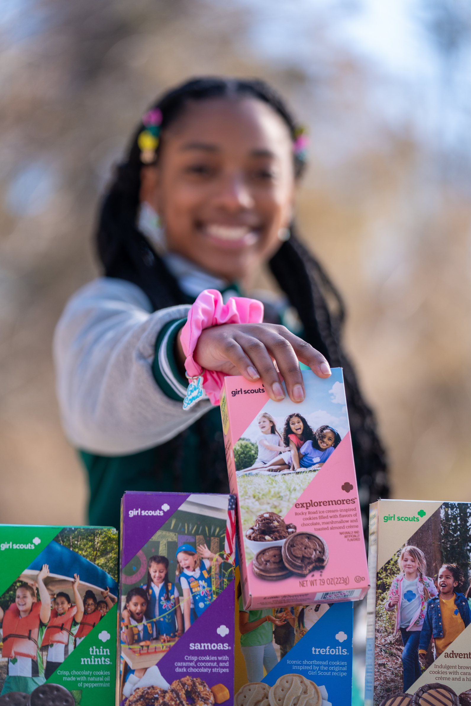
Cookie Program Overview
Largest girl-led entrepreneurial program in the world
Gives Girl Scouts the opportunity to power new, unique, and amazing experiences while also learning essential life skills
Troop earn $1 in proceeds per package sold
All proceeds from the Cookie Program stay local!

Slide 5







Cookie Information
9 cookie varieties
All varieties are $6 per package
View nutritional & allergen information on Cookie Central and on the order card

Slide 6
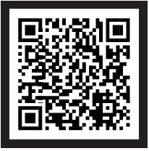

Cookie Central -Your destination for all things cookies!
Use your mobile device’s camera to scan the QR code or visit Cookie Central. From there, you can:
Access online resources
View printable resources (thank you cards, order card, door hangers, etc.)
View details on rewards, how to use Cookie Credits, & more!

Slide 7


Your Cookie Materials
Cookie Program Family Guide
Cookie Order Card
Rewards Flier
All items, plus printable resources like business cards and door hangers, can be found on Cookie Central!

Slide 8
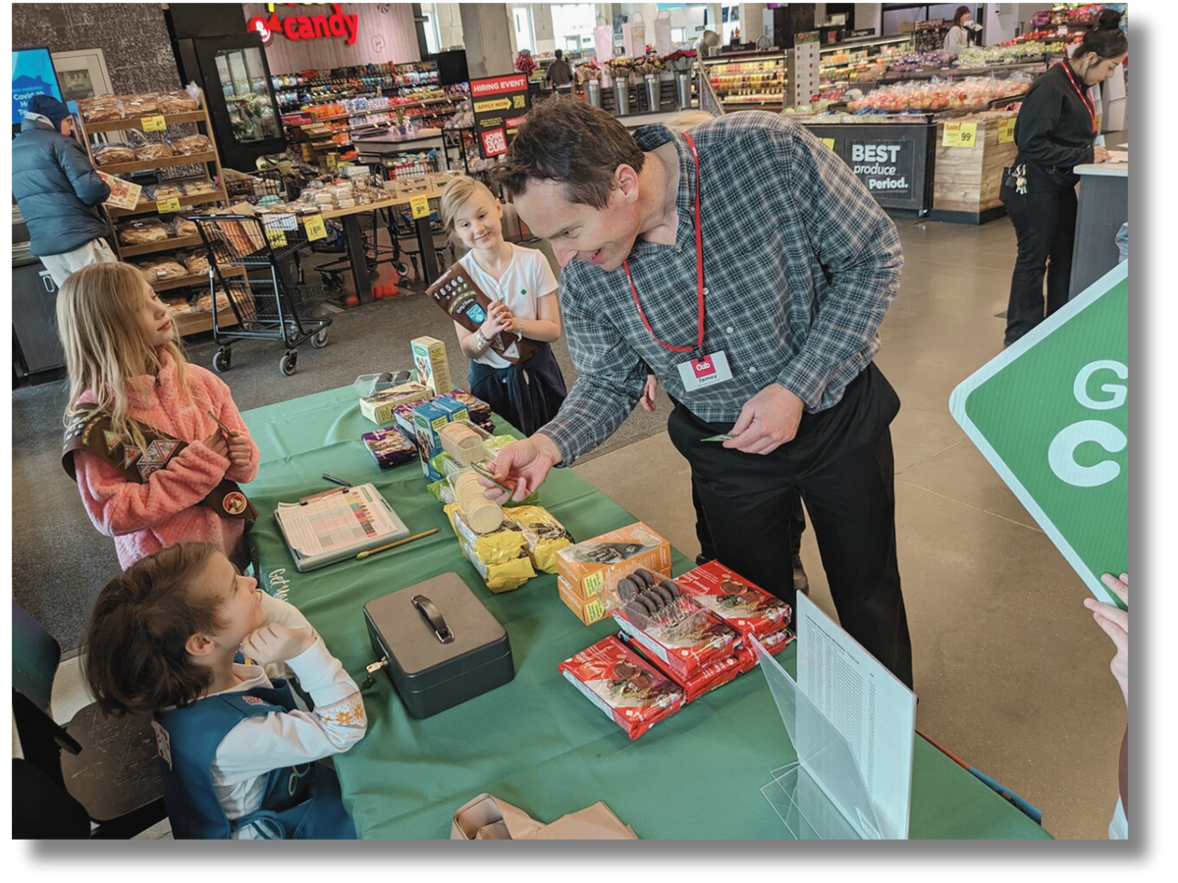
Ways to Sell Cookies
There are many ways for your
Girl Scout to sell cookies, including:
Door to Door Sales: Order Taking or Cookies in Hand
Cookie Booths and Cookie Stands
Digital Cookie Sales: Shipped or Girl Scout Delivered
Text/Call Family and Friends
Business to Business Sales (B2B)
Learn more: Navigating Ways to Participate: Tips for Troop Leadership

Slide 9


Parent/Guardian Support = Troop Success!
Simple ways that parents can support the troop:
Ask Girl Scout(s) about their goals, rewards, and how they want to sell
Review the Family Entrepreneur Pin guidelines for goal setting tips
Volunteer to support cookie booths & review our Cookie Booth Policy
Get familiar with Digital Cookie resources to learn the system: Digital Cookie Help Center for Girl Scouts and Families
Turn in money to the Troop Cookie Manager weekly and keep all receipts

Slide 10

Troop & Individual Goals
Individual Girl Scout Goals
Troop Brainstorming Session: Cookie Proceeds
What skills do you want to develop?
Is that goal achievable?
How do you plan to reach your goal?
Review last year’s goals (if they sold)
How should we use them?
What will that cost?
How many packages do we need to sell to reach our goal?
Be sure to discuss your troop's cookie donation options!

Slide 11
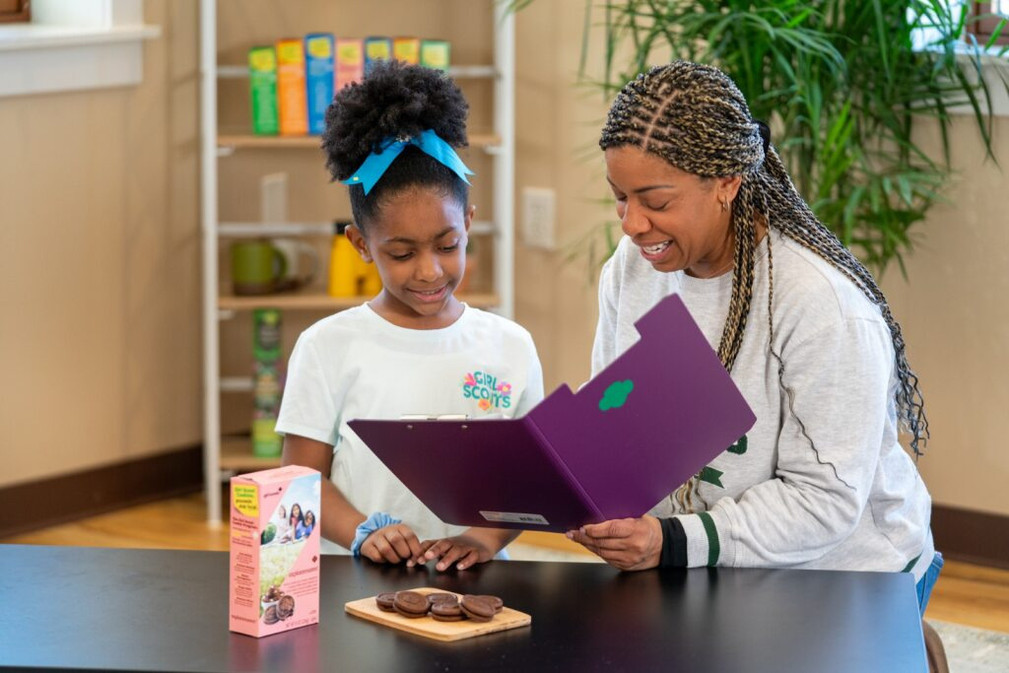
Cookie Communication & Schedule
Contact info and preferred method of contact
Family Return Date
This is the final day for Girl Scouts to return cookies to the troop!
Write the date in your Family Guide
Our Troop Cookie schedule
When orders are due
When we will visit the cupboard
When you can pick up the orders

Slide 12

Important Cookie Dates
Troop Direct Ship Sales Link Goes Live
January 6
Cookie & Booth GO Day
February 20
Cookie Sale Ends
March 29
Girl Rewards Arrive
Late May
Troop Initial Order
January 23
Presales & Online Sales Begin
February 11
Troop Reward Deadline
April 6

Slide 13

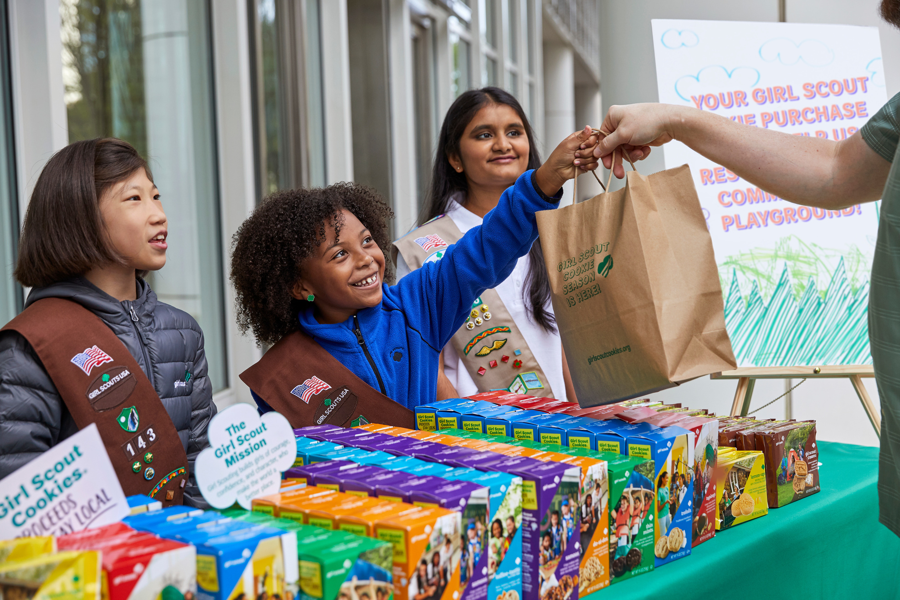
Finances
All cookies are $6 per package
Cash/checks (payable to Girl Scouts, Digital Cookie online/mobile payments
Turn in cookie money weekly
Families are responsible for cookies not returned to the troop by the Family Return Date
Troop is responsible for leftover inventory at end of sale*
*Reach out to your Troop Volunteers if you have too much extra cookie inventory!

Slide 14

Online Family Responsibility Form
Required for participation in the program & must be complete before cookies are given to families
Find this on Cookie Central
Enter the Troop Leader’s email address & troop number
Parent/caregiver & Troop Leader will both receive an email confirmation

Slide 15


Digital Cookie
Online platform for Girl Scouts and caregivers to manage online cookie sales.
Access to Digital Cookie starts on Feb. 11
Set up your online sales link (for shipped orders & in-person delivery)
Share your link by:
• Email
• Text
• Social media
• Parent/guardian workplace
Download the Digital Cookie Mobile App to accept credit card/Venmo/PayPal payments for in-person sales

Slide 16


Digital Cookie Resources
The Family Cookie Guide (print material)
Digital Cookie Help Center for Girl Scouts and Families on Cookie Central
Help section within the Digital Cookie site includes tip sheets & videos
Need Help? Email girlscouts@girlscoutsrv.org or call 800-845-0787 for assistance!

Slide 17
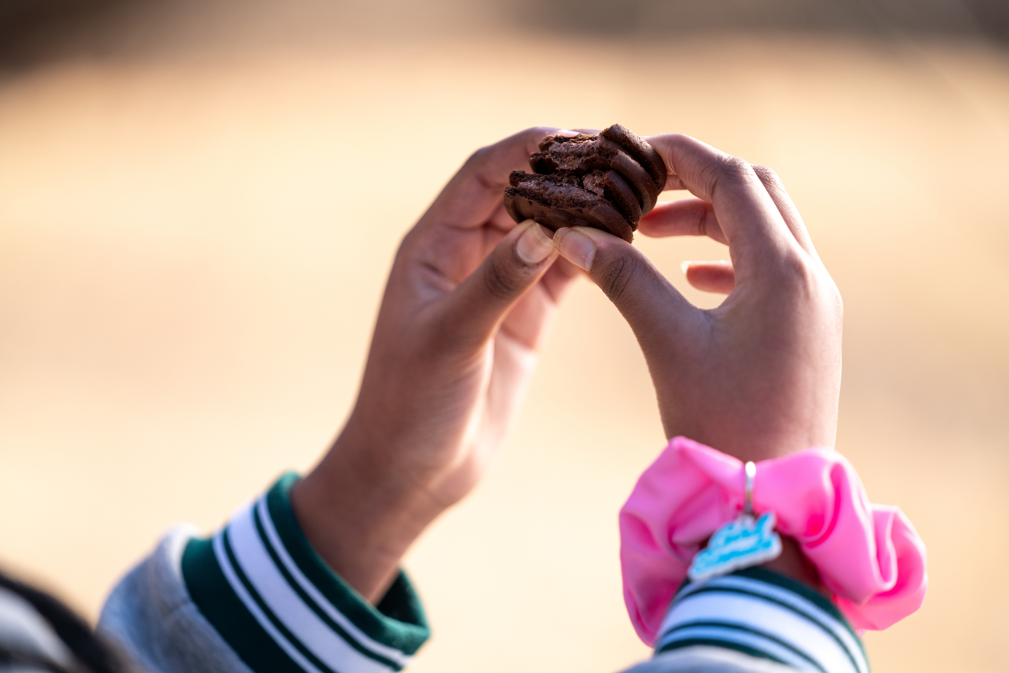

Thank You!
Questions?

