Slide 1

Welcome!
Cookie Business Family Meeting 2024

Slide 2
What we will cover…
Cookie Program Overview
Parent/Guardian Participation
Ways to Sell
Troop/Individual Goals
Communication + Cookie Schedule
Finances
Online Family Cookie Responsibility Form
Digital Cookie
Thank You! + Q&A

Slide 3
Cookie Program Overview
Largest girl-led entrepreneurial program in the world
Gives Girl Scouts the opportunity to power new, unique, and amazing experiences while also learning essential life skills
All proceeds from the Cookie Program stay local
  Keeps costs low for programs like camp and council events
  Enables GSRV to support families through financial assistance
The troop will receive proceeds per package sold
Go to Cookie Central, to learn more about the Cookie Program and for more family resources from Girl Scouts River Valleys

Slide 4

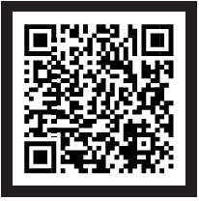
Add slide on Cookie Central
Cookie Central is your online, one-stop hub for all things cookies! Use your mobile device’s camera to scan the QR code here or visit CookieCentral. From there, you can:
Access online resources
Digital Cookie Guide
Printable resources (thank you cards, order card, door hangers, & more)
View details on rewards & how to use Cookie Credits & more!

Slide 5

Your Cookie Materials
Family Guide
Rewards Flier
Cookie Order Card
Door hangers
Business cards
Money envelope
All items can also be found on
Cookie Central!

Slide 6

Your Girl Scout Cookie Favorites Are Back!
Nine cookie varieties
All varieties are $6 per package
View nutritional & allergen information on Cookie Central
Information also available on your order card

Slide 7

Parent/Guardian Participation
Family involvement is key to troop success
Opportunities to help support the troop
Talk to your Girl Scouts about their goals
  Discuss the rewards they would like to earn & how they'd like to participate
  Review the Family Entrepreneur pin guidelines, which features goal setting information

Slide 8

Ways to Sell
Three Cookie Participation Options

Slide 9
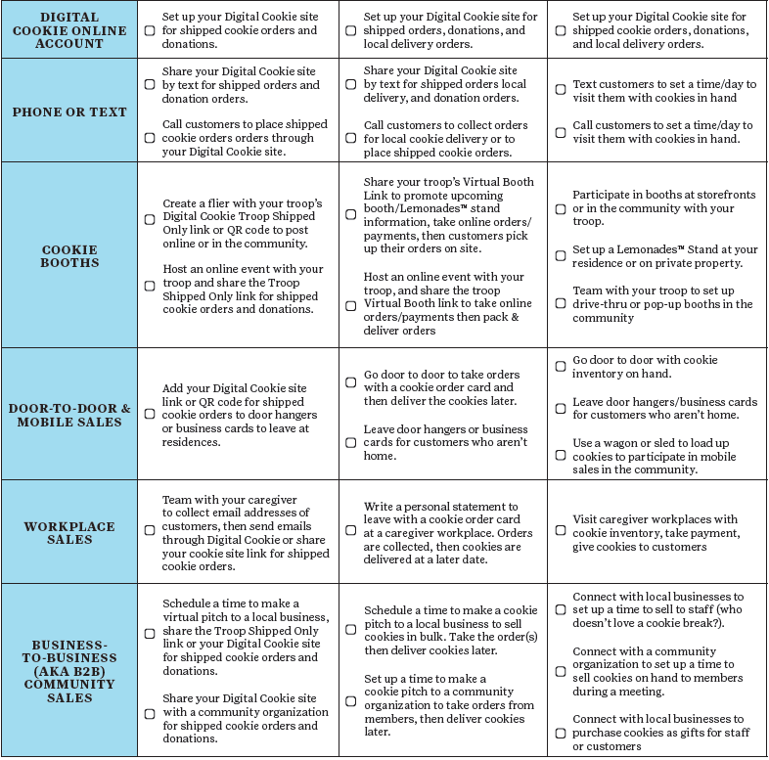

Ways to Sell
View the options in the Family Guide

Slide 10

Troop & Individual
Goals
Troop brainstorming session: cookie proceeds
  How should we use them?
  What will that cost?
  How many packages do we need to sell to reach our goal?
Individual Girl Scout goals
  Is that goal achievable?
  How do you plan to reach it?
  What skills do you want to develop?
  Review last year’s goals (if they sold)

Slide 11

Cookie Communication & Schedule
Key Dates
Troop Initial Order Fri. Jan. 19
Pre-sales & Online sales Thurs. Feb 8
Cookie Go Day Fri. Feb. 16
Booth Go Day Fri. Feb. 16
Cookie Sale Ends Sun. Mar. 24
Troop Reward Deadline Tues. Apr. 2
Girl Rewards arrive in early June
My contact info
My preferred contact method
Family Return Date
My cookie schedule

Slide 12

Finances + Family Responsibility
All cookies are $6 per package
Turn in cookie money weekly
  Must turn in 50% or more of total money due to troop before receiving more cookies.
  How payment will be collected.
  Credit card payments can be taken through Digital Cookie, at no charge for the troop! Credit card sales are credited to your Girl Scout in the system.
You are responsible for cookies not returned to the troop by the Family Return Date
Troop is responsible for leftover inventory at end of sale
  Let me know if you need help moving cookies!

Slide 13

Online Family Responsibility Form
Required for participation in the program
Must be received before cookies are given to families
Can be found on Cookie Central
Enter my email address & troop number
You & I will both receive email confirmation

Slide 14

Digital Cookie
Digital Cookie is the new online platform that Girl Scouts and caregivers use for digital cookie sales.
All Girl Scouts and their families will get access to Digital Cookie on February 1st
Girl Scouts can use their Digital Cookie account to set up their online account sales link which they can share by email, text, social media, or even their parent/guardian workspaces:
  Shipped cookie orders
  Girl Scout Cookie delivery orders

Slide 15
Digital Cookie
Digital Cookie has great new features!
Customize your site & explore the learning activities
Ability for customers to purchase and pay online for local delivery
  You can turn on/off local delivery at any time
Approve orders for local delivery in the site
  You’ll receive an email reminder to login and approve orders if you have outstanding orders to approve
  Note: Online orders for local delivery must be approved within 5 days or the order is cancelled.
Ability to turn on/off cookie varieties for local delivery
A robust Help section built right into the site with tip sheets & videos to assist if you need them

Slide 16
Digital Cookie
Digital Cookie Resources
Family Guide
Digital Cookie Guide for Families on Cookie Central
Help section in the site with tip sheets & videos
Watch for information on joining a Digital Cookie Rally in Rallyhood for families to connect on questions
Digital Cookie office hours provided by Girl Scouts River Valleys staff

Slide 17


Thank You!
Questions?

